Slide 1

Machine Learning
By : Khaled Tarek

Slide 2


Agenda:
What is Machine Learning?
Why use Machine Learning?
Data Preprocessing.
Regression
- Simple Linear Regression - Multiple Linear Regression
- Polynomial Regression - Decision Tree Regression
- Support Vector Regression (SVR) -Random Forest Regression
- Evaluating Regression Models Performance
- Regression Model Selection

Slide 3

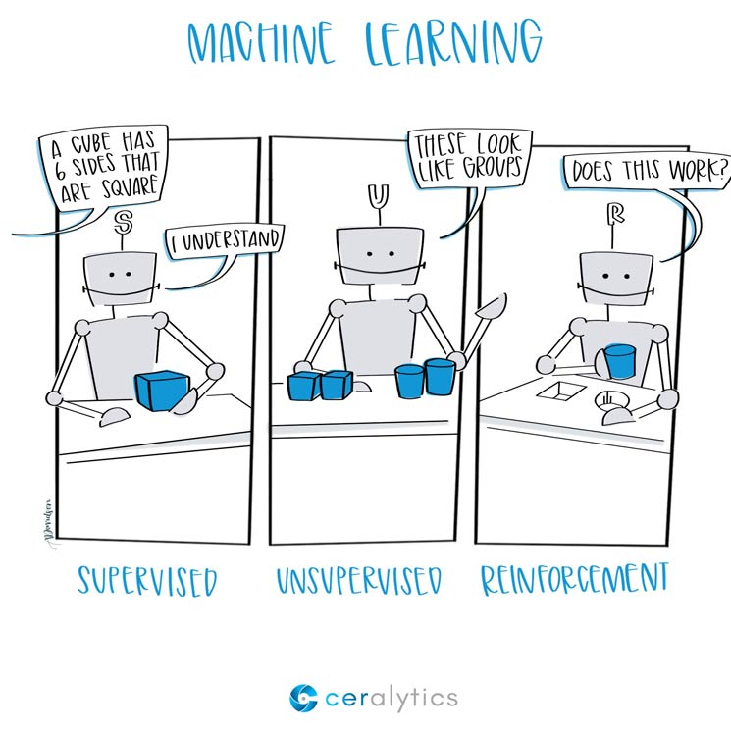
What is Machine Learning?
Machine Learning is the science (and art) of programming computers so they can learn from data and field of study that gives computers the ability to learn without being explicitly programmed.

Slide 4
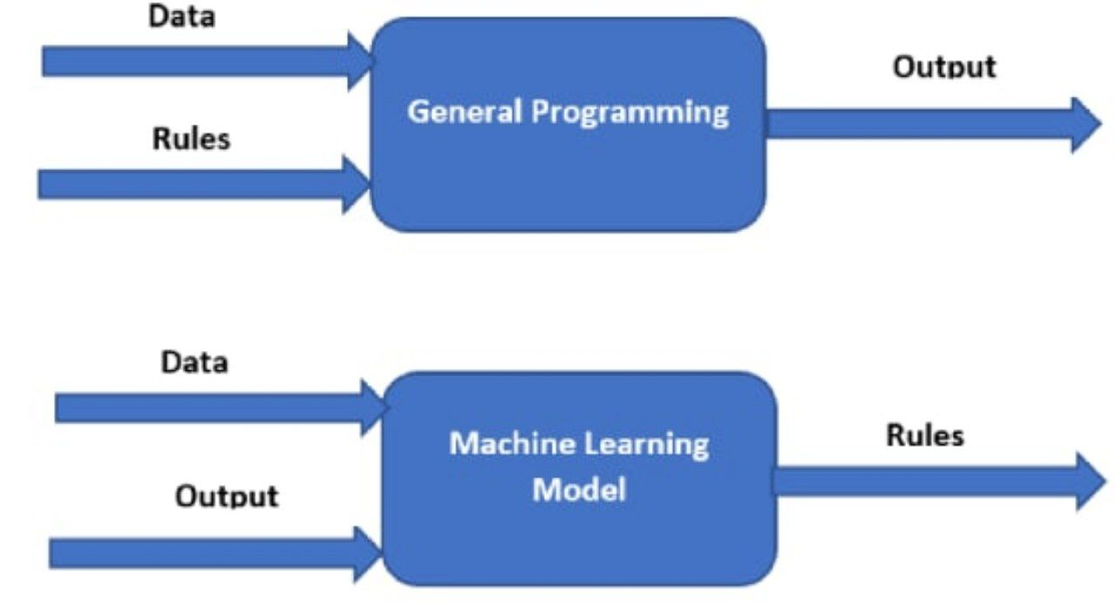

Slide 5
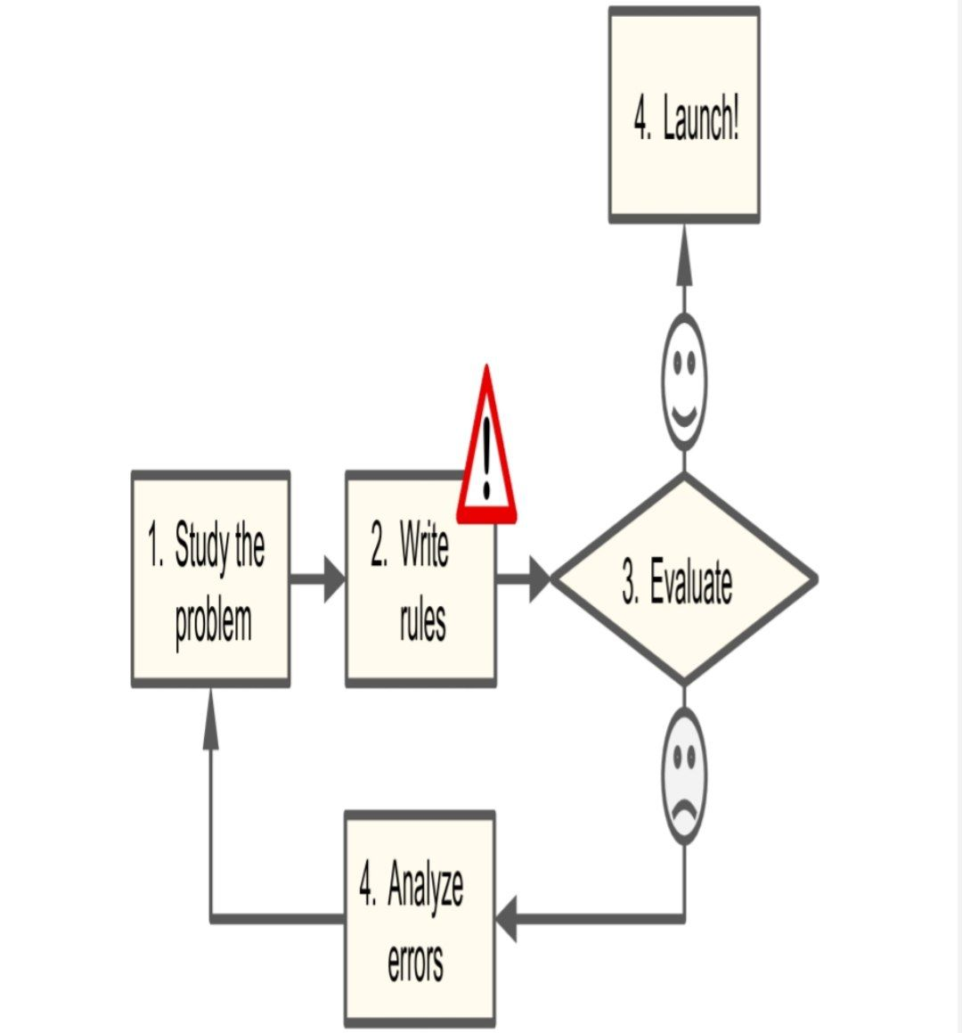
Why Use Machine Learning?
Consider how you would write a spam filter using traditional programming techniques
EDIT SLIDE

Slide 6
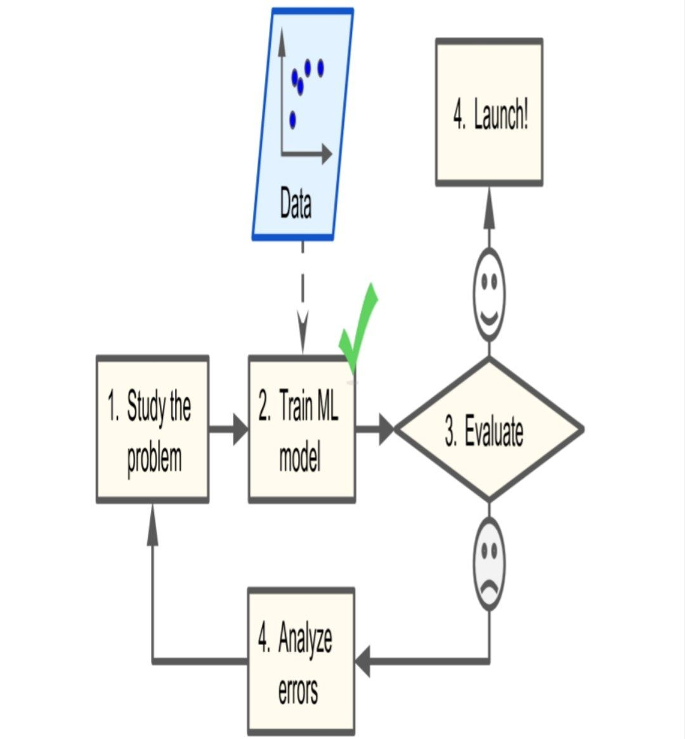
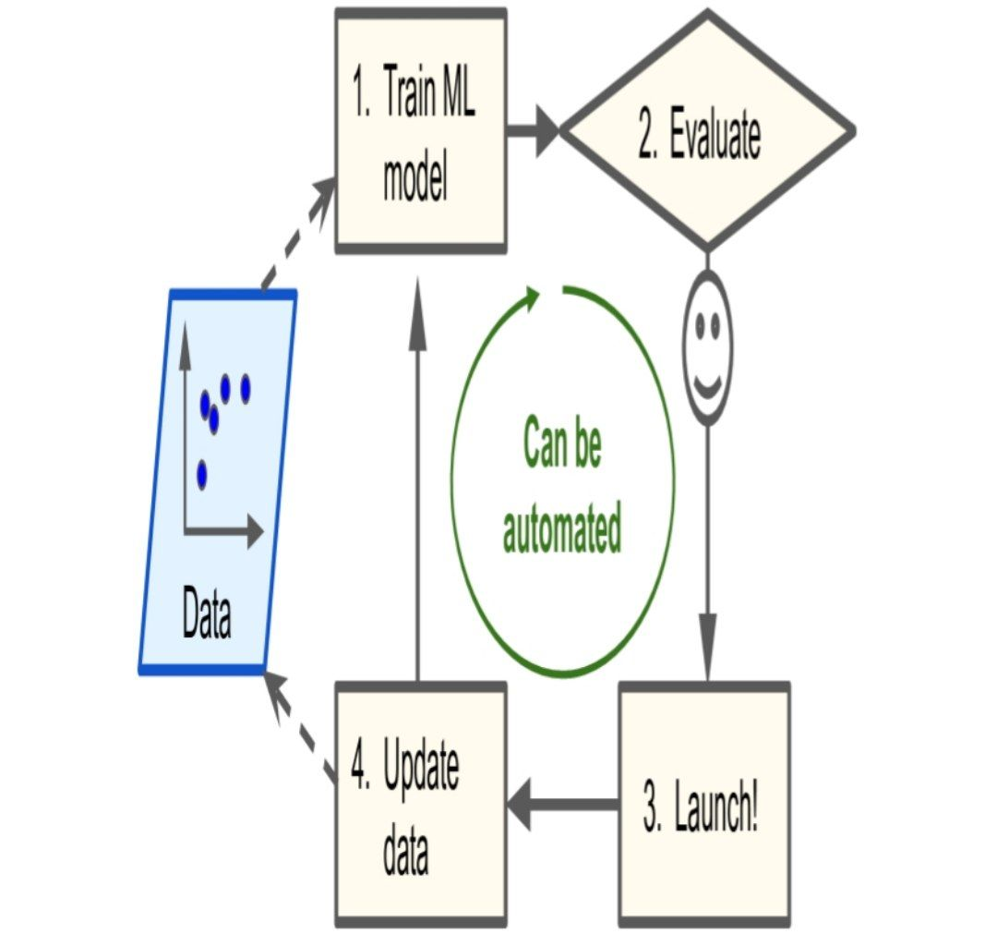
In contrast, a spam filter based on Machine Learning techniques automatically notices that “For U” has become unusually frequent in spam flagged by users, and it starts flagging them without your intervention
EDIT SLIDE

Slide 7
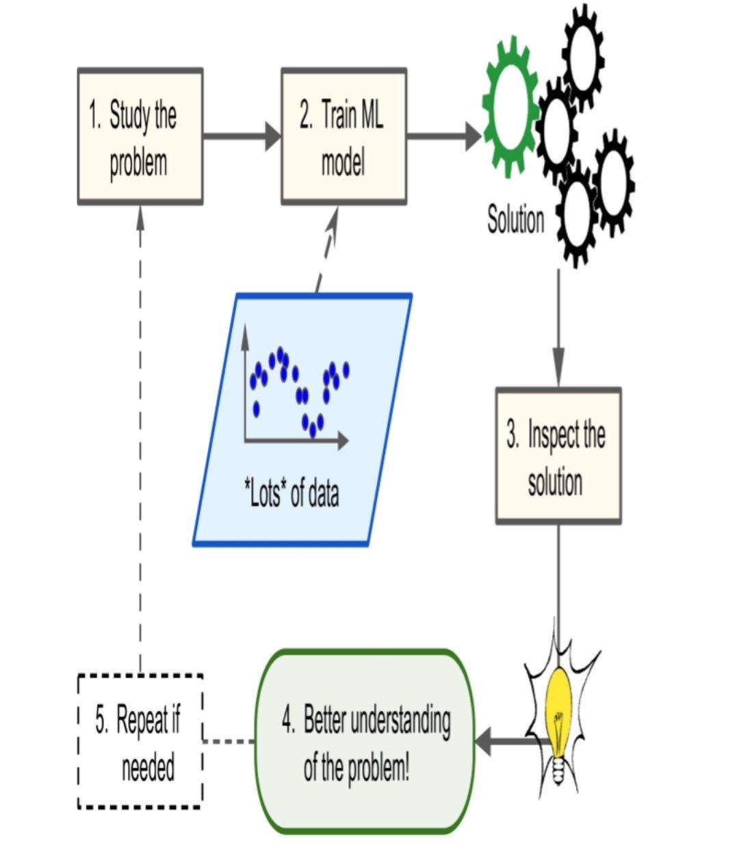
EDIT SLIDE
.

Slide 8
Data Preprocessing
Importing the dataset
Encoding categorical data
Feature Scaling
01
03
05
06
02
04
Importing
the libraries
Taking care of missing data
Splitting the dataset into the Training set and Test set

Slide 9
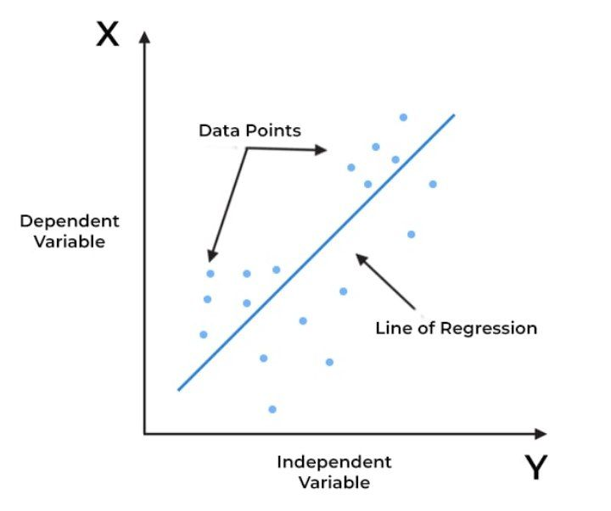
Regression
Regression is defined as a statistical method that helps us to analyze and understand the relationship between two or more variables of interest.
regression analysis helps to understand which factors are important, which factors can be ignored, and how they are influencing each other.
EDIT SLIDE
For example,
it can be used to quantify the relative impacts of age, gender, and diet (the predictors) on weight (the output or dependent).
- House prices based on size, locations,…
- Salary prediction based on experience
- Stock Market prediction
- Weather prediction
- …
.

Slide 10
Regression
Simple Linear Regression
Multiple Linear Regression
Polynomial Regression
Support Vector Machine (SVR)
Decision Tree Regression
Random Forest Regression
Evaluating Regression Models Performance
- Regression Model Selection
EDIT SLIDE
.

Slide 11
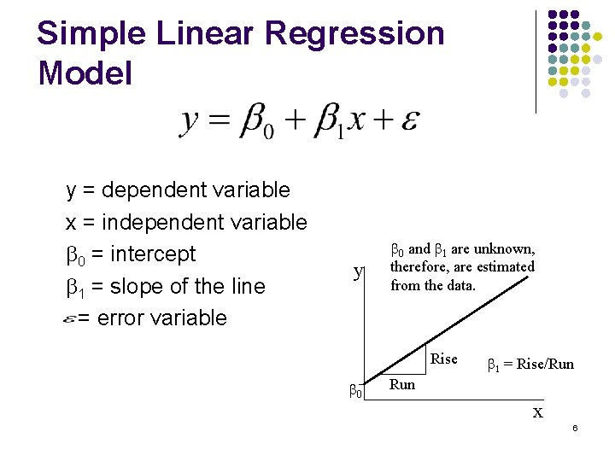
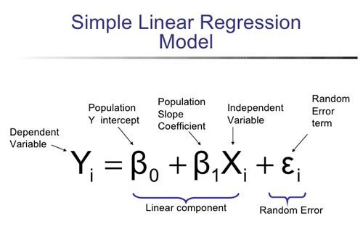
1- Simple Linear Regression (Equation of a straight line)
It also called ordinary least squares (OLS)

Slide 12
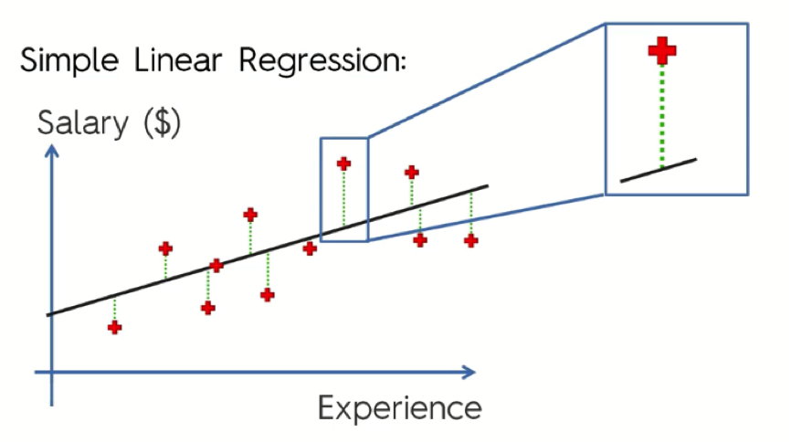
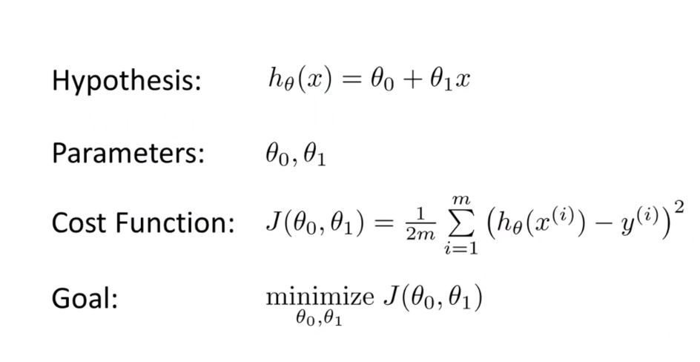
1- Simple Linear Regression (Calculate Cost Function)
The goal is to minimize the sum of squares of residuals (y-y’) is as small as possible

Slide 13
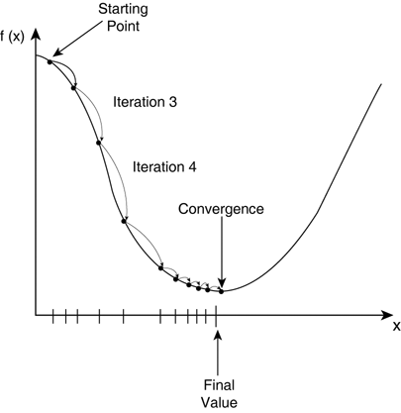
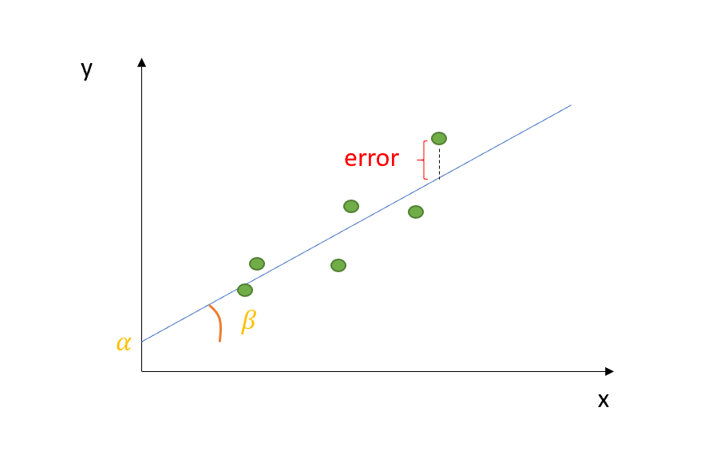
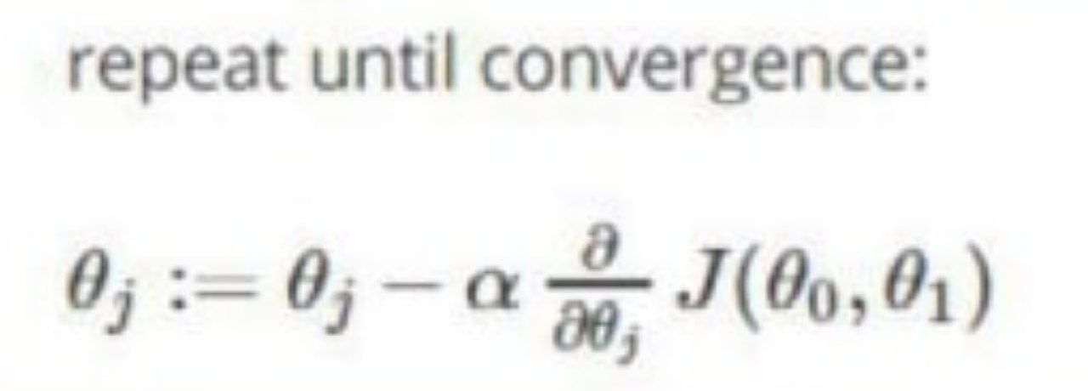
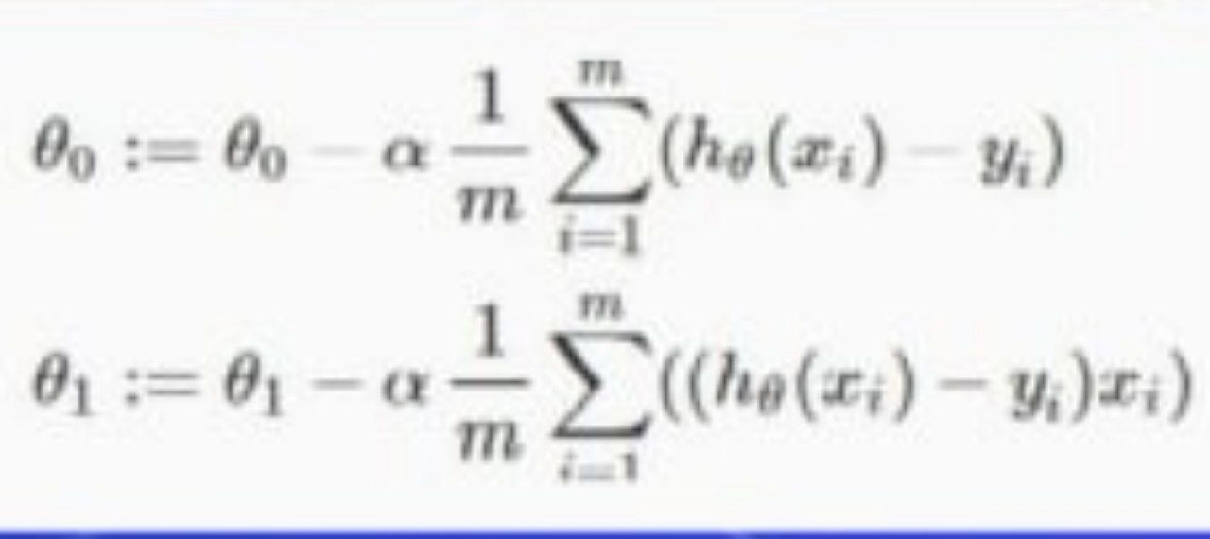
1- Simple Linear Regression (Minimize cost using Gradient Descent)

Slide 14
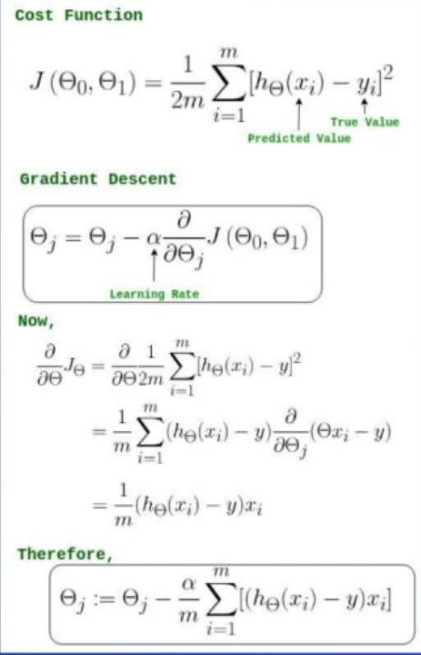
1- Simple Linear Regression (Minimize cost using Gradient Descent)

Slide 15
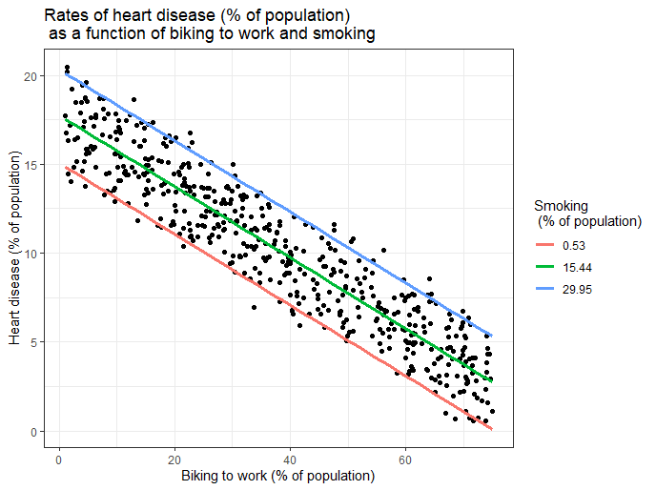
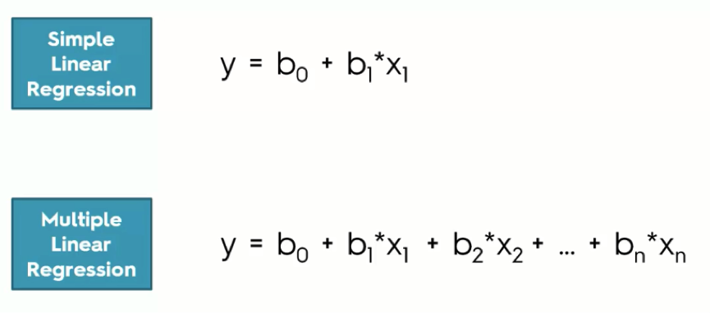
2-Multiple Linear Regression (Equation)

Slide 16
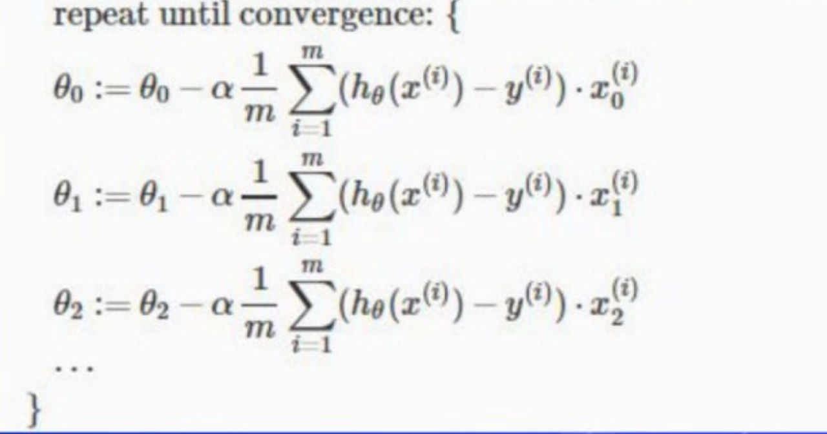
2- Multiple Linear Regression (Update theta values)

Slide 17
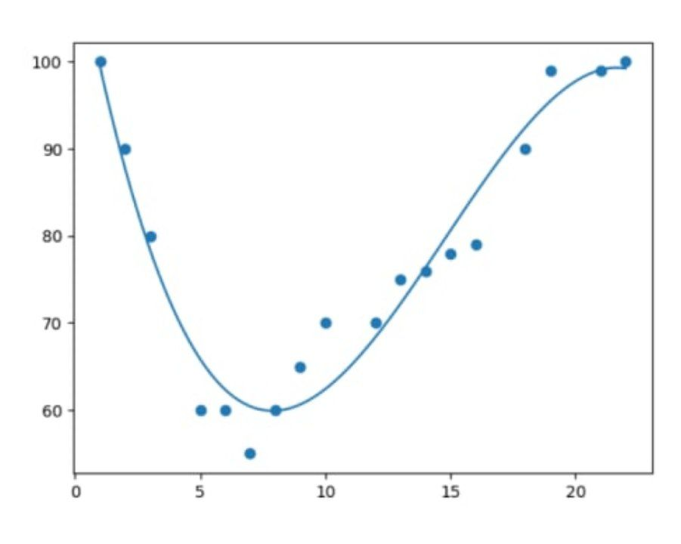
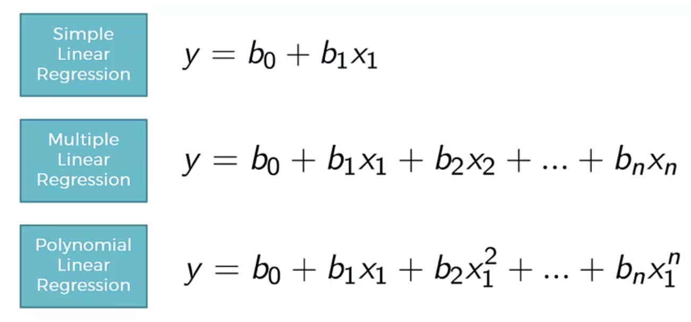
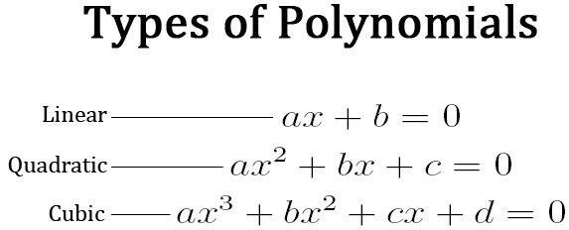
3-Polynomial Regression (Poly equation)
If your data points clearly will not fit a linear regression (a straight line through all data points), it might be ideal for polynomial regression.
Polynomial regression, like linear regression, uses the relationship between the variables x and y to find the best way to draw a line through the data points

Slide 18
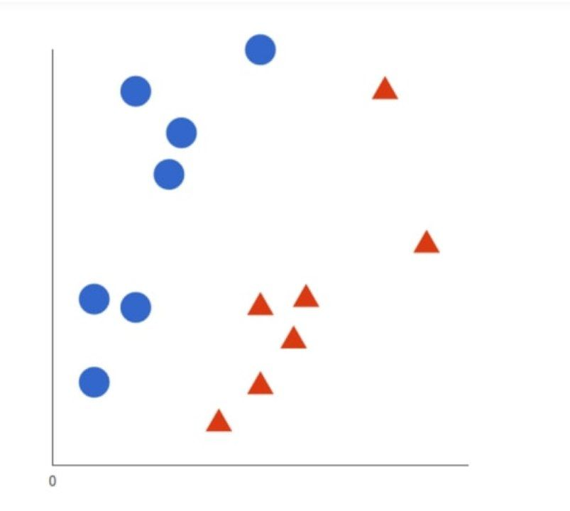
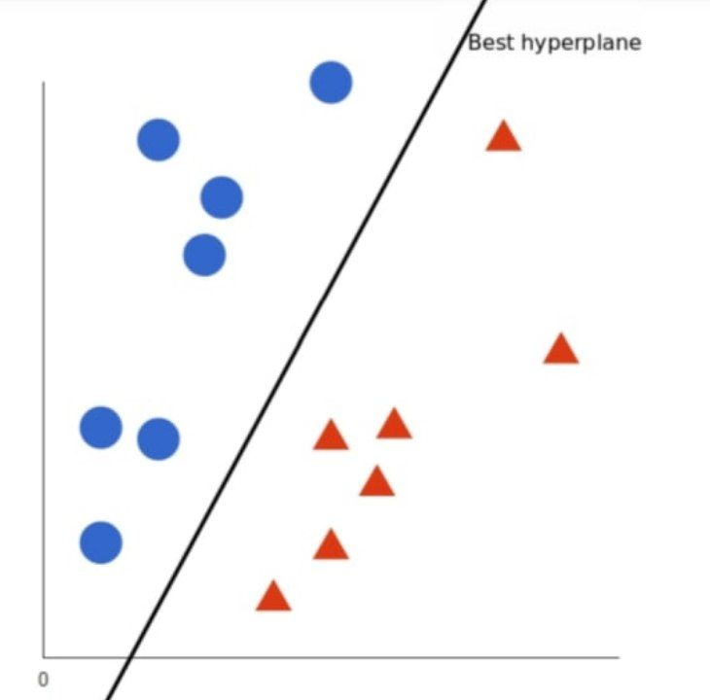
4- Support Vector Machine (SVR)
- A support vector machine (SVM) is a supervised machine learning model that uses classification algorithms for two-group classification problems. After giving an SVM model sets of labeled training data for each category, they’re able to categorize new text.
- they have two main advantages: higher speed and better performance with a limited number of samples (in the thousands)
Let’s imagine we have two tags: red and blue, and our data has two features: x and y. We want a classifier that, given a pair of (x,y) coordinates, outputs if it’s either red or blue.
A support vector machine takes these data points and outputs the hyperplane (which in two dimensions it’s simply a line) that best separates the tags. This line is the decision boundary: anything that falls to one side of it we will classify as blue, and anything that falls to the other as red.

Slide 19
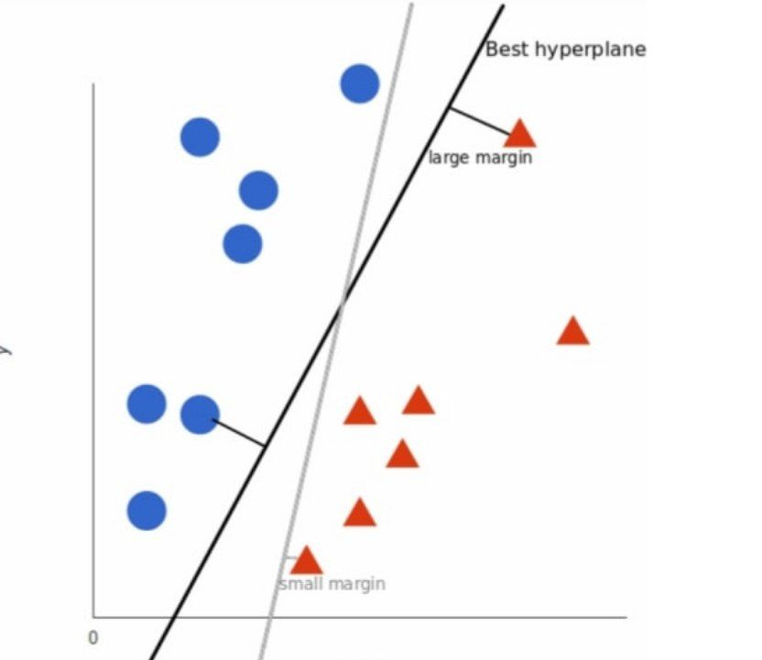
4- Support Vector Machine (SVR)
But, what exactly is the best hyperplane? For SVM, it’s the one that maximizes the margins from both tags. In other words: the hyperplane (remember it's a line in this case) whose distance to the nearest element of each tag is the largest.

Slide 20
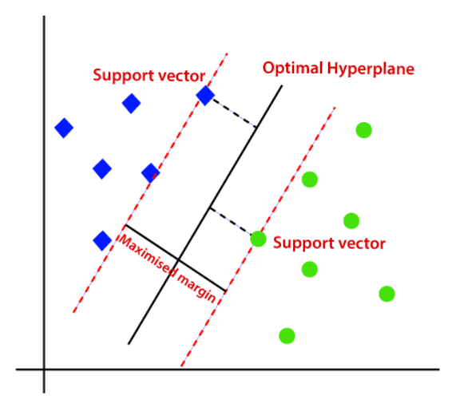
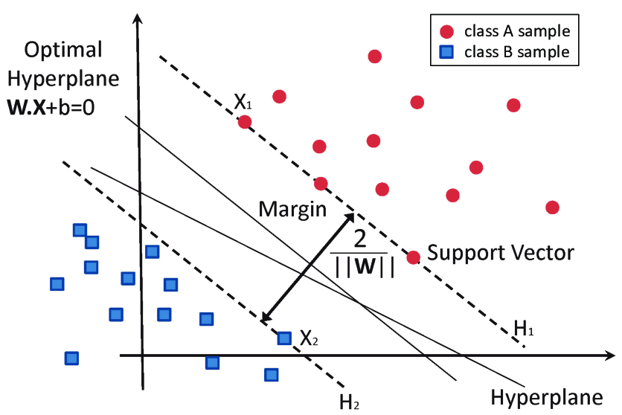
4- Support Vector Machine (SVR)

Slide 21
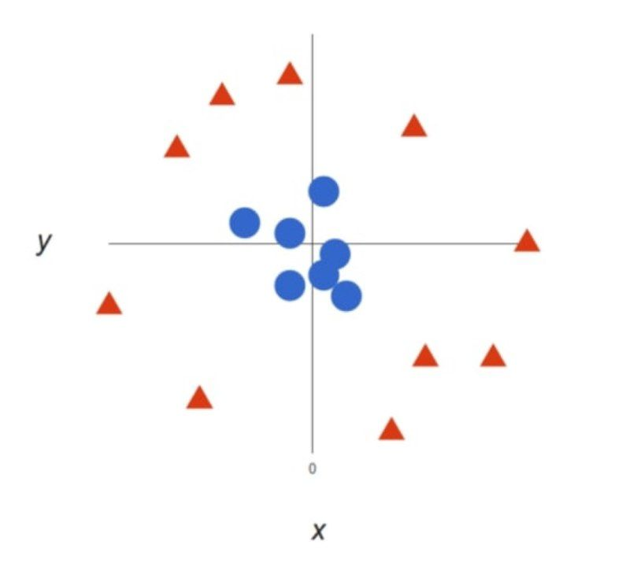
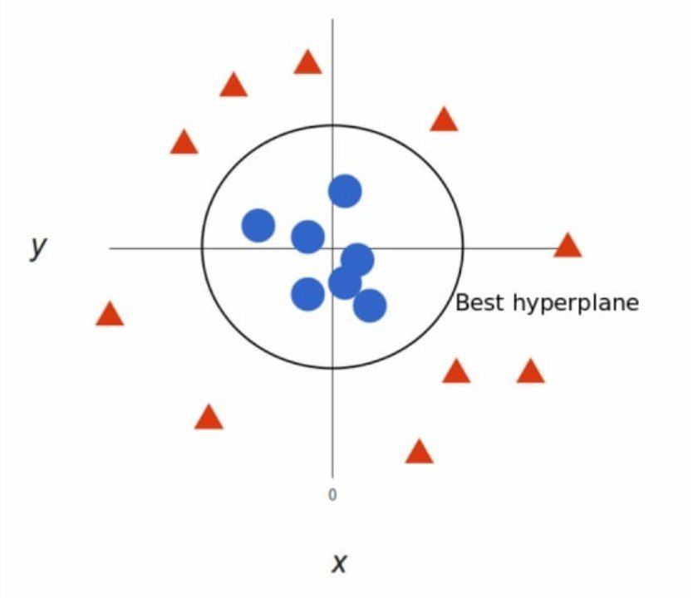
4- Support Vector Machine (SVR) “Not Linear”

Slide 22
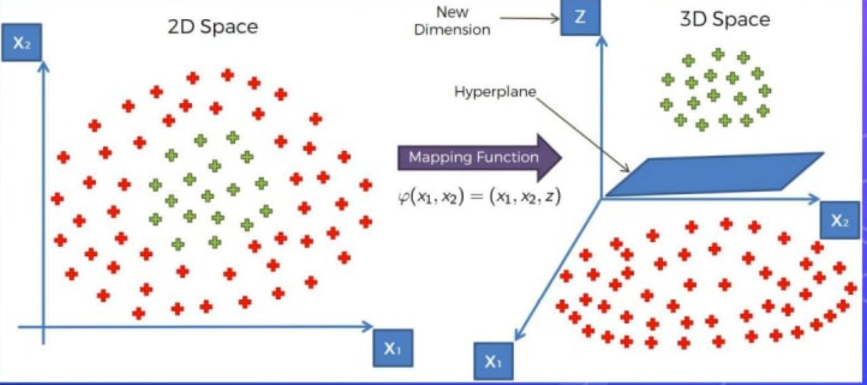
4- Support Vector Machine (SVR)

Slide 23
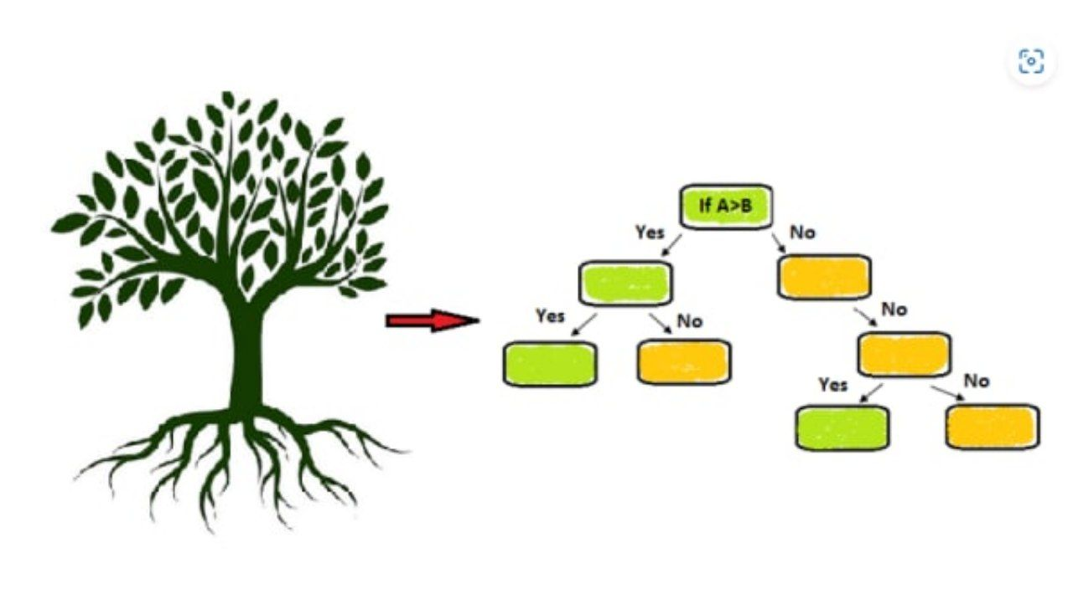
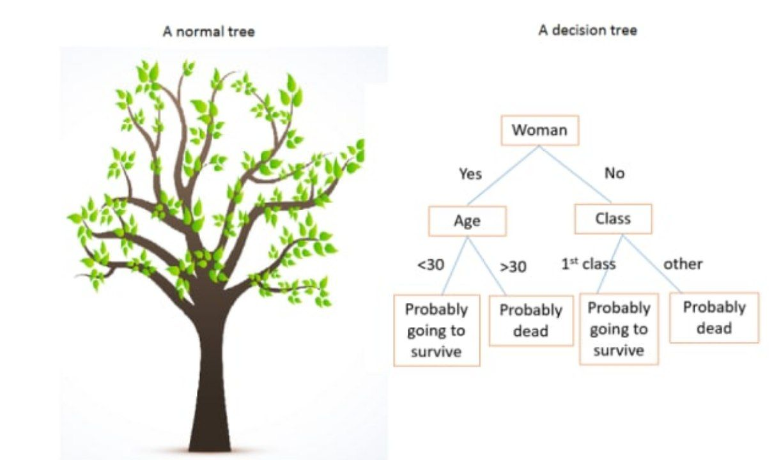
5-Decision Tree Regression
The Decision Tree Algorithm: Discover This Powerful Tool
A decision tree is a graphical representation of possible solutions to a problem, where each node in the tree represents a possible decision, and the branches represent the possible consequences of each decision
.

Slide 24
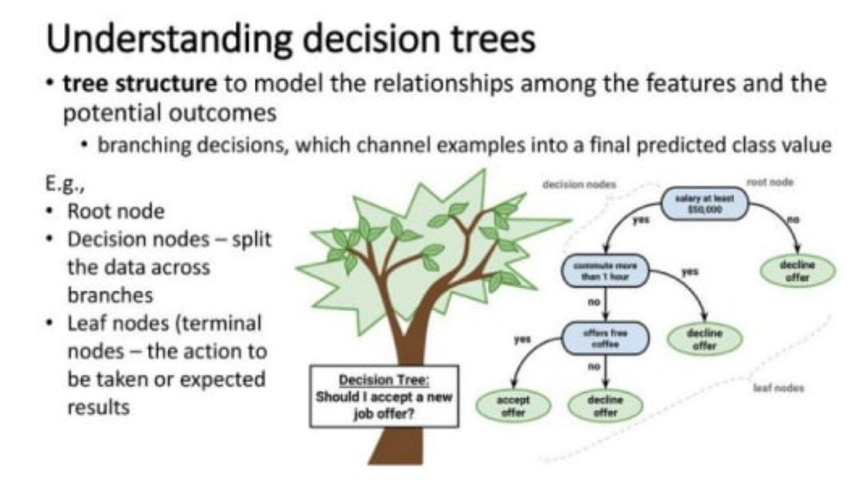
5-Decision Tree Regression
What is a Decision Tree Algorithm?
A decision tree algorithm is a tool that can be used to help make decisions by creating a tree-like structure of possible solutions.
The algorithm starts with a root node, which represents the initial decision to be made, and then expands the tree by adding nodes for each possible decision until a final decision is reached.
How does a Decision Tree Algorithm work?
The decision tree algorithm works by starting with a root node, which represents the initial decision to be made.
The algorithm then expands the tree by adding nodes for each possible decision, until a final decision is reached.
The algorithm is designed to help make decisions by creating a tree-like structure of possible solutions.

Slide 25
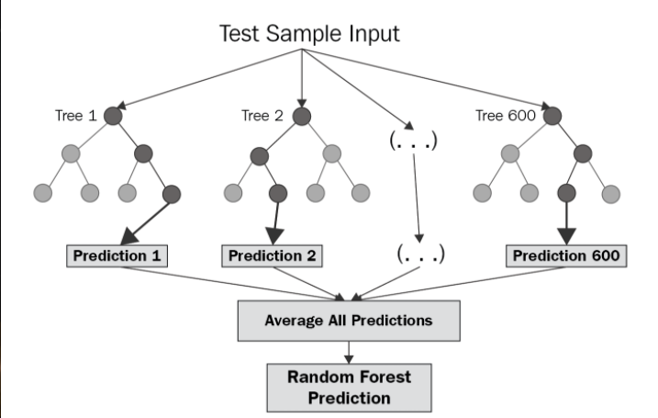
5- Random Forests
Random Forest is an ensemble technique capable of performing both regression and classification tasks with the use of multiple decision trees and a technique called Bootstrap and Aggregation, commonly known as bagging. The basic idea behind this is to combine multiple decision trees in determining the final output rather than relying on individual decision trees.
Random Forest has multiple decision trees as base learning models. We randomly perform row sampling and feature sampling from the dataset forming sample datasets for every model. This part is called Bootstrap.

Slide 26
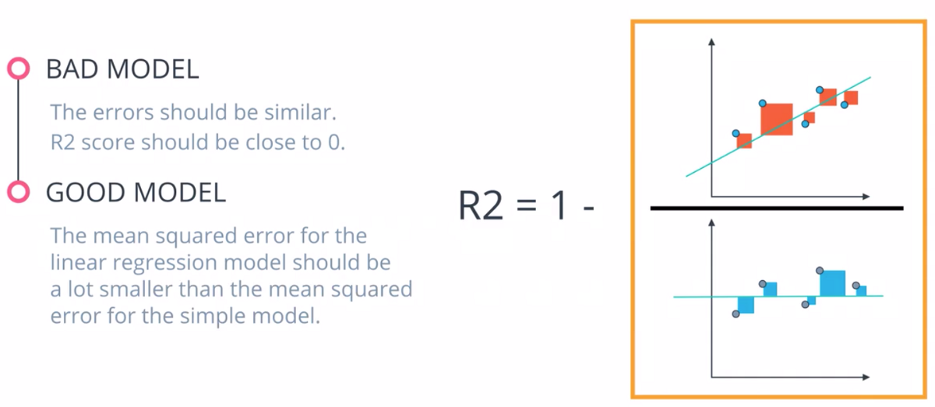
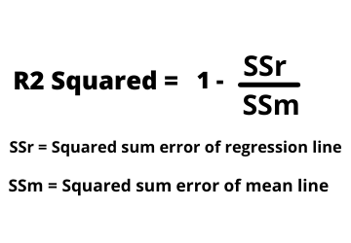
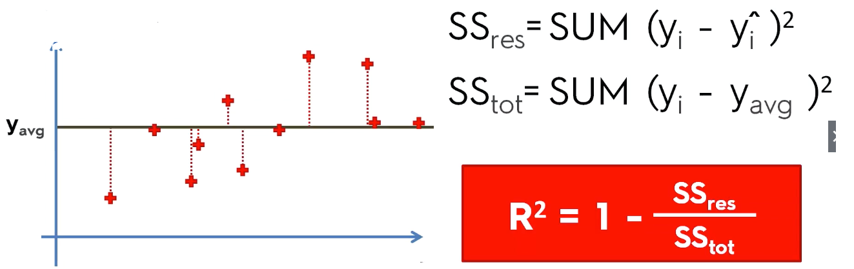
6- Evaluating Regression Models Performance (R2)

Slide 27
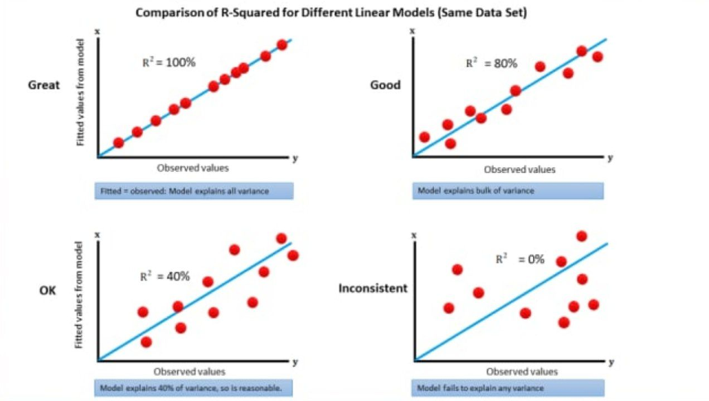
6- Evaluating Regression Models Performance (R2)

Slide 28
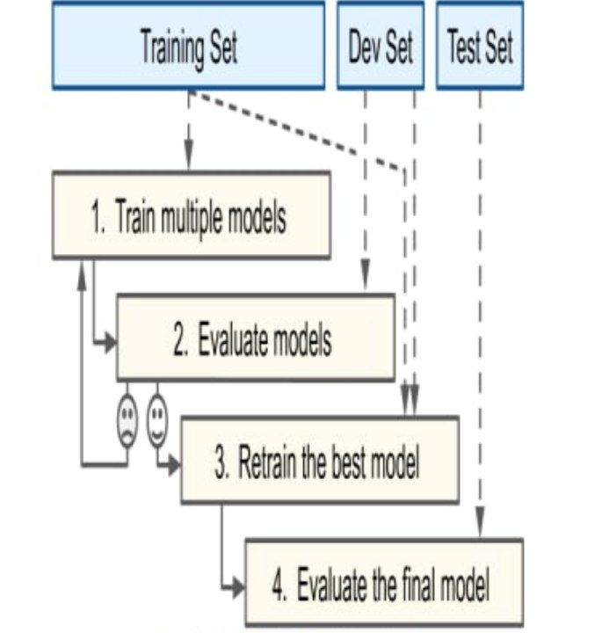
7- Regression Model Selection
suppose you are hesitating between two types of models (say, a linear model and a polynomial model): how can you decide between them?
One option is to train both and compare how well they generalize using the test set.
A common solution to this problem is called holdout validation you simply hold out part of the training set to evaluate several
candidate models and select the best one. The new held-out set is called the validation set (or the development set, or dev set). More specifically, you train multiple models with various hyperparameters on the reduced training set (i.e., the full training set minus the validation set), and you select the
model that performs best on the validation set. After this holdout validation process, you train the best model on the full training set (including the validation set), and this gives you the final model. Lastly, you evaluate this final model on the test set to get an estimate of the generalization error

Slide 29

THANK YOU
Khaled Tarek

